Slide 1
GOVT. COLLEGE ROPAR
DEPARTMENT OF ECONOMICS
TOPIC :- CLASSICAL MODEL OF GROWTH
INTRODUCTION
MODEL
ASSUMPTIONS
LIMITATIONS
PROF. RITU
SEM 5

Slide 2
Classical Growth Theory
The Classical Growth Theory postulates that a country’s economic growth will decrease with an increasing population and limited resources. Such a postulation is an implication of the belief of classical growth theory economists who think that a temporary increase in real GDP per person inevitably leads to a population explosion, which would limit a nation’s resources, consequently lowering real GDP. As a result, the country’s economic growth will start to slow.

Slide 3
ASSUMPTIONS
The economy is a laissez faire economy.
The economy has a sectors, viz. agricultural sector and industrial sector.
Agriculture is subject law of diminishing returns.
The supply of labour tends to increase following improvements in the standard of living of the workers.
There is perfect competition in the economy.
Labour and Capital are the two variable inputs.
The principle of subsistence law of wages or iron law of wages holds good.
Say’s law of the markets holds good.

Slide 4
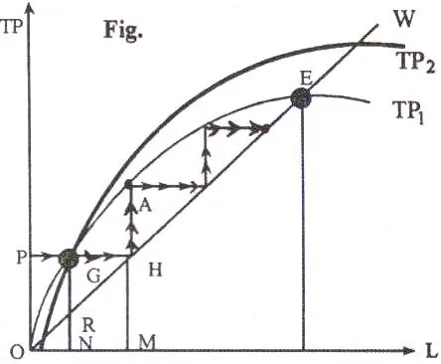
Structural Model

Slide 5
Explanation about model structure
In the chart above, the y-axis represents total production, and the x-axis represents labor. Curve OW outlines the total subsistence wages. If the level of population (labor) is ON, and the level of output is OP, the per capita wage is represented by NR. Consequently, the surplus or profit is RG.
Because of the surplus, the capital formation process comes into effect. Consequently, the demand for labor increases, leading to a rise in total wages, as the curve moves to GH. If the total population remains constant at ON, and wages exceed subsistence wages, i.e., NG > NR, then total population or total manpower will increase as the curve moves toward OM. Because of the increase in population, surplus can be generated.
In such a manner, the process will continue until the economy reaches point E, as depicted by the arrow. Point E represents a stationary situation wherein wages and total output equalize, and no surplus can be generated. However, according to classical economists, with technological progress the production function will shift upward, as depicted by the curve TP2. Also, according to the Classical Growth Theory, economic stagnation can be postponed, although ultimately not avoided.

Slide 6
Limitations of the Classical Growth Model
Ignorance with respect to technology: The classical model of growth ignores the role efficient technical progress could play for the smooth running of an economy. Advancements in technology can minimize diminishing returns.
Inaccurate determination of total wages: The classical model of growth assumes that total wages do not exceed or fall below the subsistence level. However, this is not entirely true. Changes in the industrial structure and substantial economic development can result in total wages exceeding or falling below the subsistence level. Moreover, the classical theory of growth does not consider the role played by trade unions in the process of wage determination.

Slide 7
2. Neoclassical Growth Model
The Neoclassical Growth Theory is an economic model of growth that outlines how a steady economic growth rate results when three economic forces come into play: labor, capital, and technology. The simplest and most popular version of the Neoclassical Growth Model is the Solow-Swan Growth Model.
The theory postulates that short-term economic equilibrium is a result of varying amounts of labor and capital that play a vital role in the production process. The theory argues that technological change significantly influences the overall functioning of an economy. Neoclassical growth theory outlines the three factors necessary for a growing economy. However, the theory puts emphasis on its claim that temporary, or short-term equilibrium, is different from long-term equilibrium and does not require any of the three factors

Slide 8
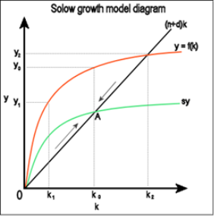
Solow equation

Slide 9
Production Function in the Neoclassical Growth Model
The Neoclassical Growth Model claims that capital accumulation in an economy, and how people make use of it, is important for determining economic growth.
It further claims that the relationship between capital and labor in an economy determines its total output. Finally, the theory states that technology augments labor productivity, increasing the total output through increased efficiency of labor. Therefore, the production function of the neoclassical growth model is used to measure the economic growth and equilibrium of an economy. The general production function in the neoclassical growth model takes the following form

Slide 10
FUNCTIONS:-
Y = AF (K, L)
Where:
Y – Income, or the economy’s Gross Domestic Product (GDP)
K – Capital
L – Amount of unskilled labor in the economy
A – Determinant level of technology
Also, because of the dynamic relationship between labor and technology, an economy’s production function is often re-stated as Y = F (K, AL). This states that technology is labor augmenting and that workers’ productivity depends on the level of technology.

Slide 11

Meade’s equation
Y=F (K, L, N, t)
∆Y=V ∆K + W ∆L + ∆Y’
∆Y/Y= annual proportionate rate of growth of output,
∆K/K= annual proportionate rate of growth of the stock of machinery,
∆L/L= annual proportionate rate of growth in the working population, and
∆Y’/Y = annual proportionate rate of growth of output due simply to technical progress. y = Uk+ Ql + r

Slide 12
THANK YOU
G

